Slide 1
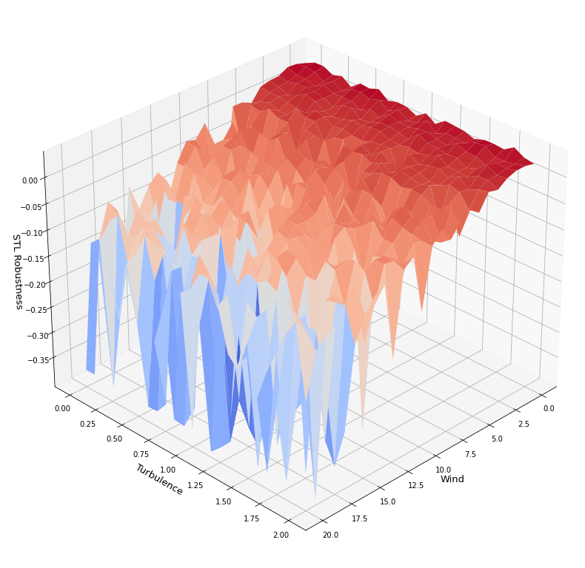
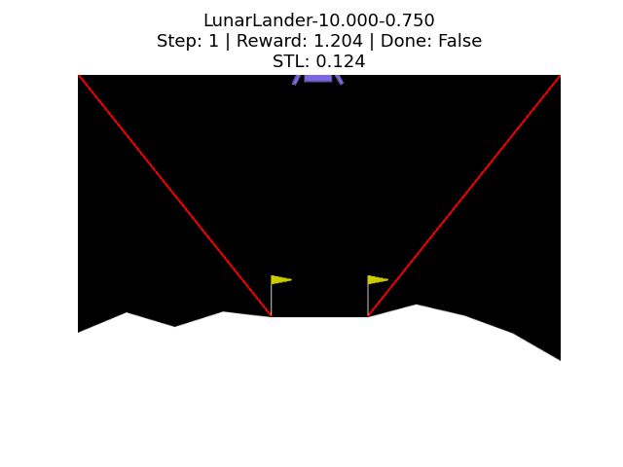
Environmental Deviations and Robustness

Slide 2
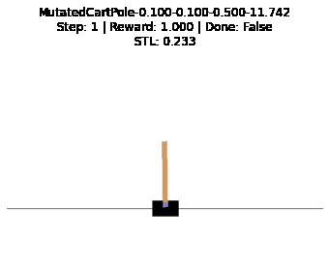
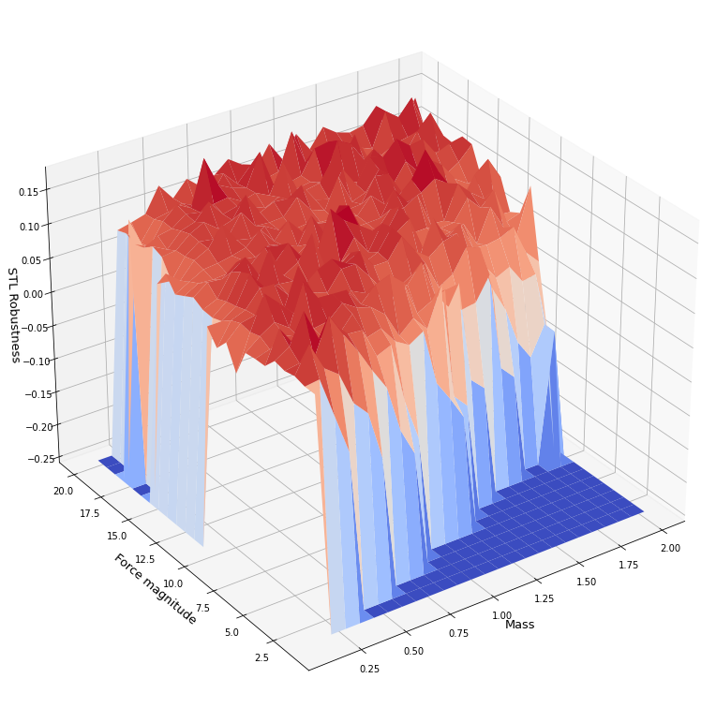
Environmental Deviations and Robustness

Slide 3
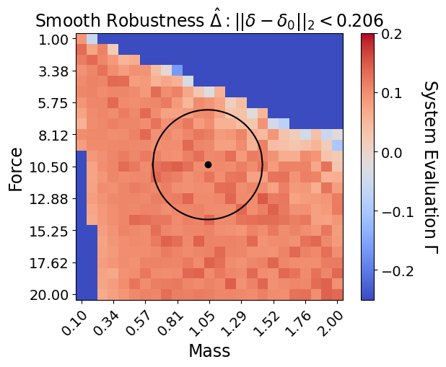
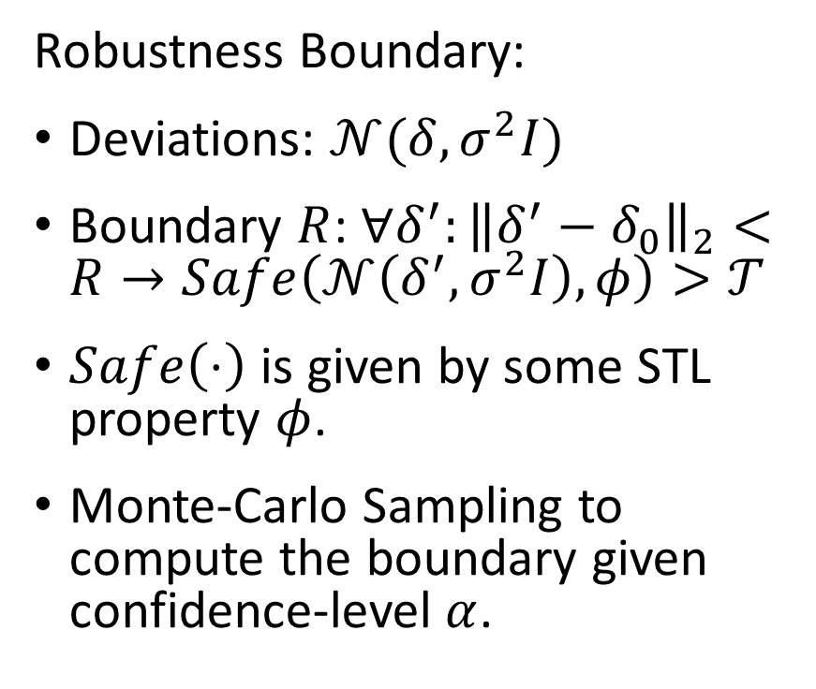
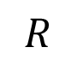
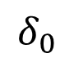
Robustness Boundary
Robustness Boundary:
Deviations: $𝒩(δ,σ^{2}I)$
Boundary $R$: $∀δ^{′}:{\left\|δ^{′}−δ_{0}\right\|}_{2}<R→Safe\left(𝒩\left(δ^{′},σ^{2}I\right),φ\right)>𝒯$
$Safe\left(⋅\right)$ is given by some STL property $φ$.
Monte-Carlo Sampling to compute the boundary given confidence-level $α$.
$$R$$
$$δ_{0}$$

Slide 4
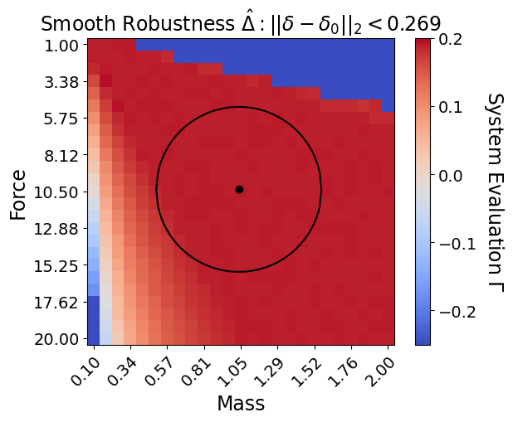
Traditional Controller vs NN Controller

Slide 5
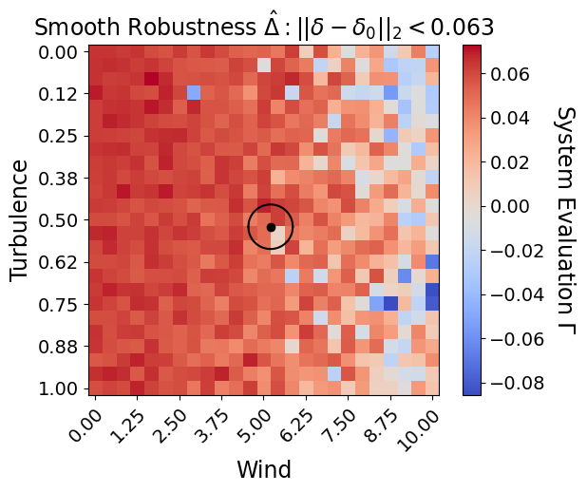
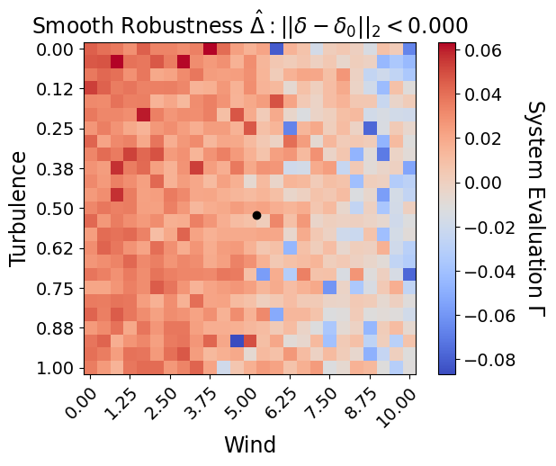

Slide 6
